Slide 1
Certification Management System
Syed Salif Moin

Slide 2
Abstract
Certification Management System is an application designed to manage, organize and track Certifications by Employees. The system can be accessed by two types of users who manages the whole certification requests process, starting from creating record for Employees to generating Certification Request for them, keeping track of the status of the Certification Request whether it has been approved or not till marking the final status as pass or fail for that Certification Request.

Slide 3
Objectives
Team Collaboration : Salesforce also lets you easily communicate with the other members of your team. The “Chatter” feature lets you talk with individuals or groups about work-related information.
Flexibility : The system is easily modifiable depending on the changing need of the users.
Accessibility : Salesforce being a cloud platform, the application will be wherever you have Internet access.

Slide 4
Technology Used
JavaScript
Apex
HTML and CSS
XML
AURA

Slide 5
Inscope
There are two categories of users who would access the system:
The App Admin :
Registers and manages Vouchers
Registers and manages Certifications
Approves or Rejects the Certification Request Approval Request by App Users
View reports and dashboards
Views charts
The App User :
Registers and manages Employees
Registers and manages Certification Requests
Raises a Certification Request Approval Request
View reports and dashboards
Views charts

Slide 6
Outscope
The following functionalities has not been included in the system:
The app in no place includes billing and payment procedures of Voucher or Certification Request.
Employee is not a salesforce user and has to mail the App User for Certification Requests.

Slide 7
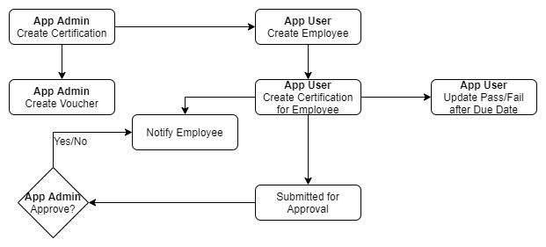
Operation Steps

Slide 8
Thank You

